Slide 1

HANDYWOMEN
FRANCHISE
Joining fee £299
we LOVE small to medium sized jobs
www.mrsjobi.uk

Slide 2


Slide 3


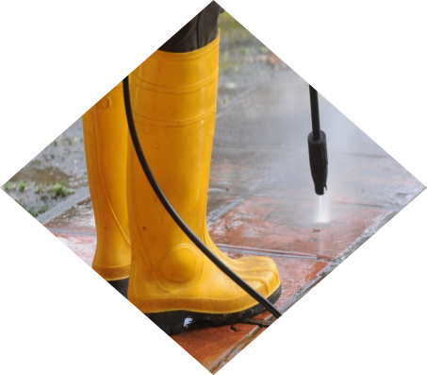
A few Services You Can Offer
You can offer as many services as you wish & expand at any time
We will fully customize to your services
Handywomen
Tiling
Power Washing
Our handywomen service covers a wide range of services that clients need undertaken ranging from fitting simple wall shelving through to tackling long lists of required tasks!
Some Mrs Jobi local franchise owners offer tiling services to their clients. Regardless of it being just a few rows of sink splashback tiles to larger sized projects.
Power washing or alternatively named 'Jet Cleaning' is guaranteed to bring AMAZING cleaning results. Mrs Jobi local operators can make grubby looking items sparkle like new.

Slide 4


+ A few More Services You May Want to Add
You get to choose the services to offer your clients
Painting & staining
Small plumbing jobs
Flat packs
Our Mrs Jobi local operators can offer a comprehensive service with most offering painting, glossing and staining services.
When your clients are in true need of 'HELP!’, as a Mrs Jobi handywomen franchisee, you could be the perfect 1st call by isolating the water feed.
This is most peoples biggest dislike when buying all manner of new items. If you join us as a franchisee, your clients will no doubt keep you BUSY.

Slide 5
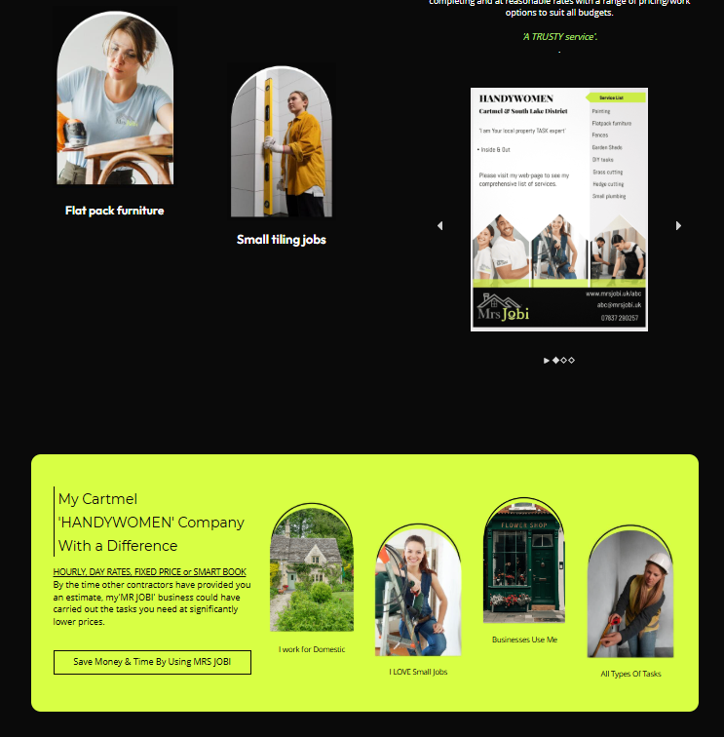
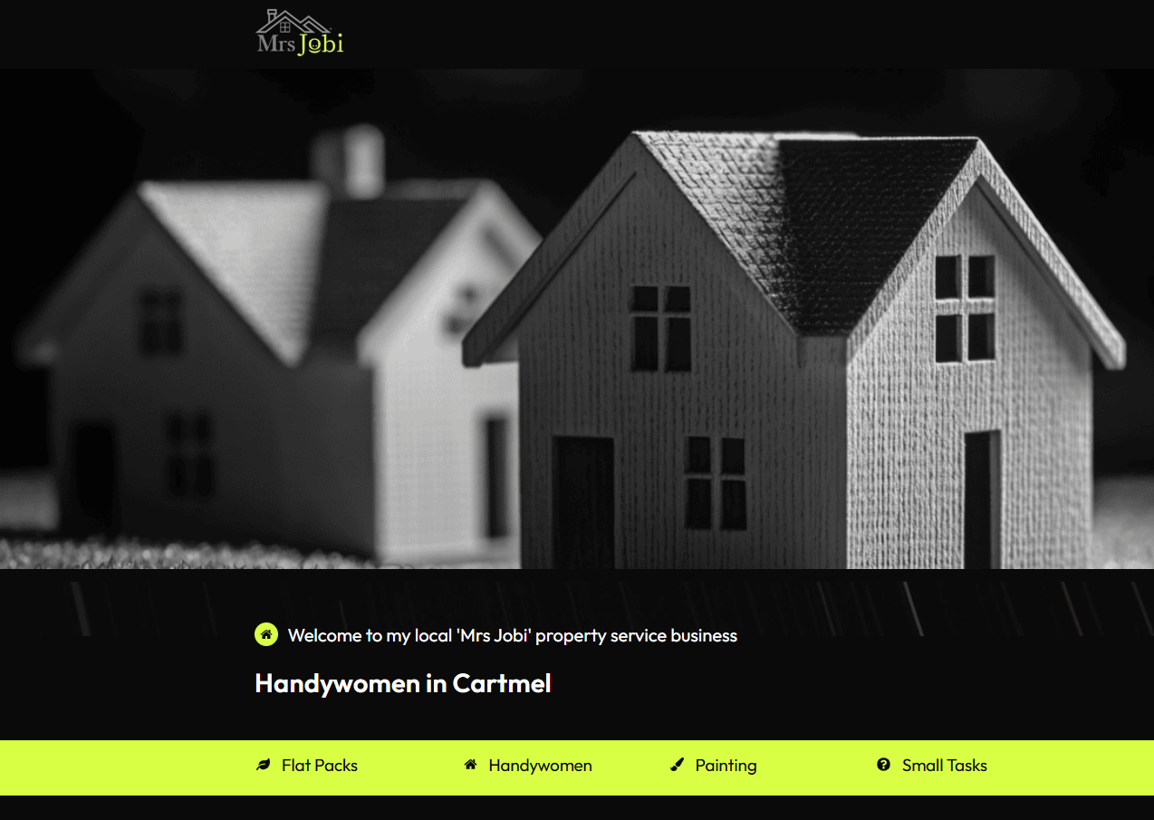
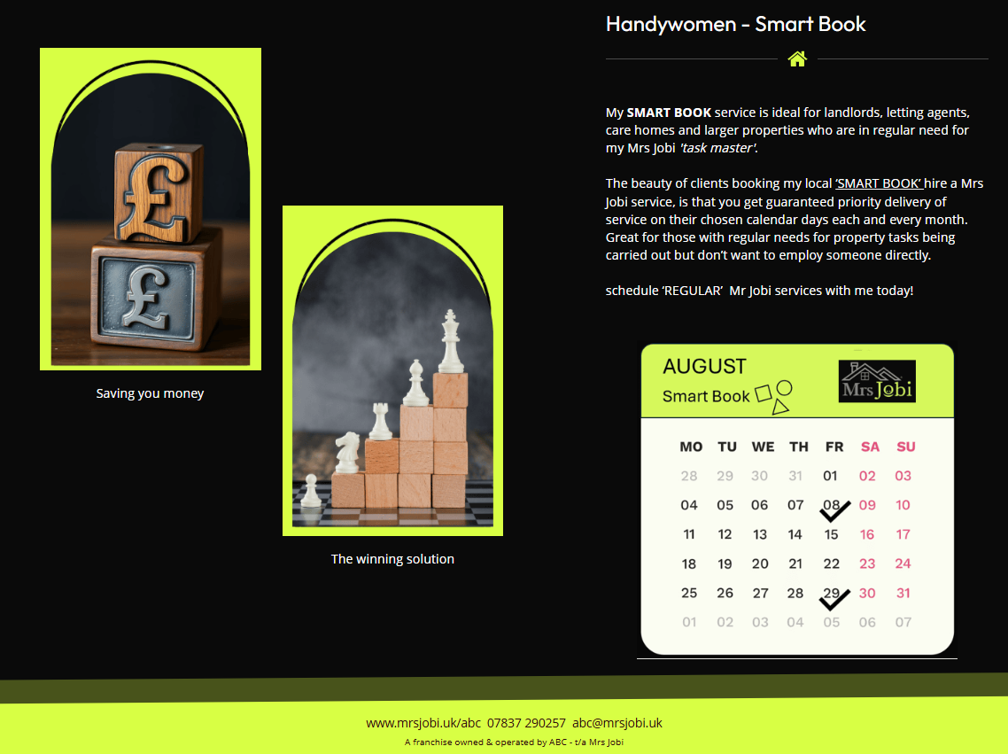
You receive a VERY attractive webpage fully customized for you in your chosen work area/s
Example page 1 Google, search ‘handywomen in Cartmel’ www.mrsjobi.uk/abc

Slide 6
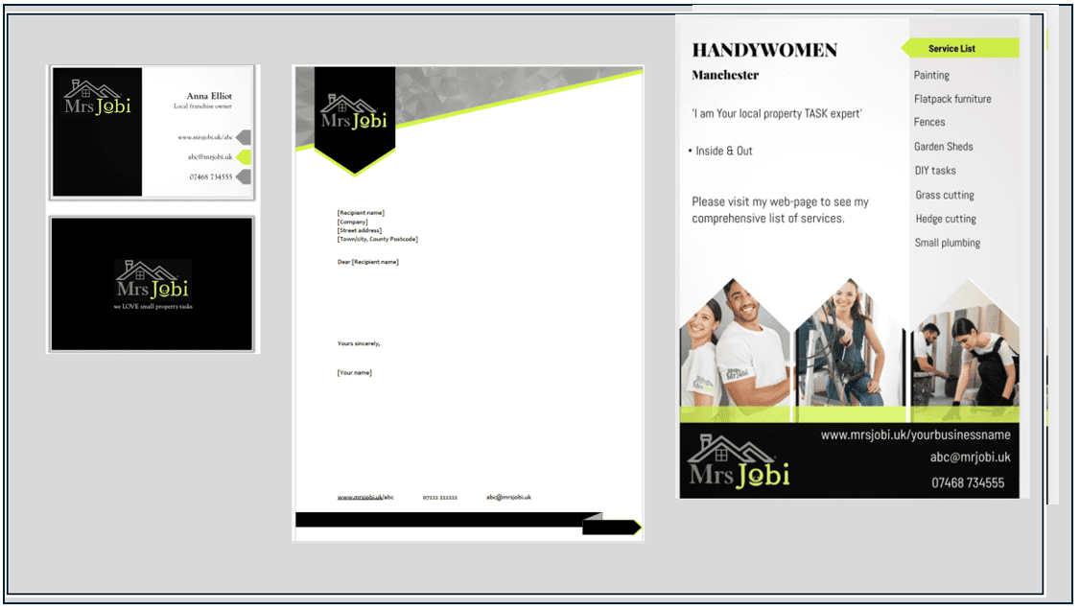
You will look so professional
Mrs Jobi local franchisees receive a combination of professional e-business cards, e-brochures, e-letter header paper. You can purchase at low cost printed colour flyers, quality embroidered polos or t-shirts and more from our shop at any time. www.mrsjobi.uk/shop

Slide 7
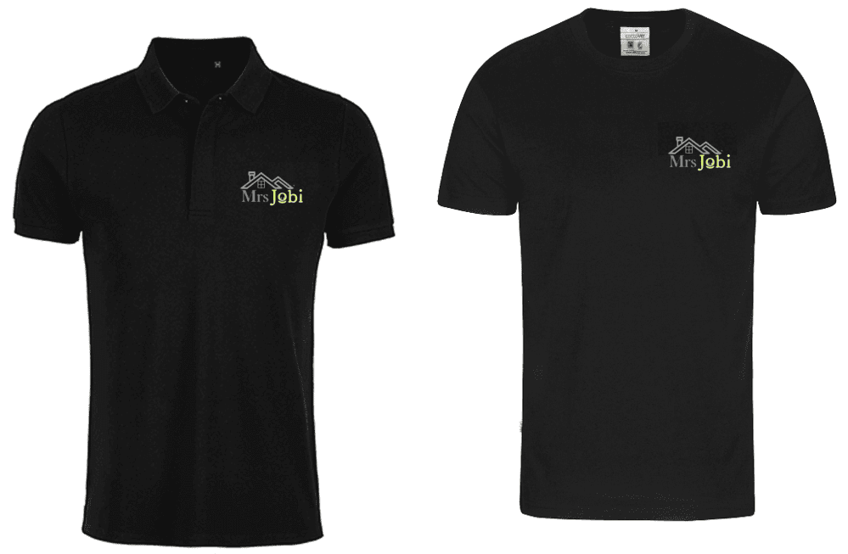
Great value franchise £299

Slide 8


Your Own LOCAL FOCUSED Promo video + Hosting Mrs Jobi provides
(CLICK image below to see example of local franchises video)

Slide 9




Join Our Growing National 'Property CARE' Company With a Difference
YOU CAN SET HOURLY, DAY RATES, FIXED PRICES OR SMART BOOK
.
Make GREAT money
You choose the jobs to take on
Mrs Jobi a Winning Company
Businesses LOVE
Mrs Jobi

Slide 10

We invite you to join the ‘Mrs Jobi' network

Slide 11
Meet Mrs Jobi
Mrs Jobi even LOVES the more unusual tasks and thrives on lists.
A REFRESHING change to what’s out there!

Slide 12
Franchise Financials
£299
JOINING FEE: customised to your local MRS JOBI business
£39
ACCOUNT MAINTENANCE: just £39 p/m or just £25 p/m on our yearly paid in advanced plan. Both options covers all your franchise operating system as described on
www.mrsjobi.uk/franchise
£0
Pay zero 0% royalty and commission ever
£0
Hidden costs

Slide 13

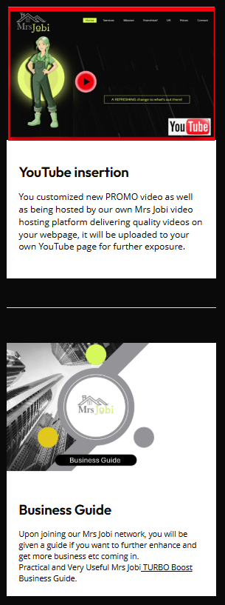
You really do receive so much when you join us at Mrs Jobi.
www.mrsjobi.uk/abc

Slide 14
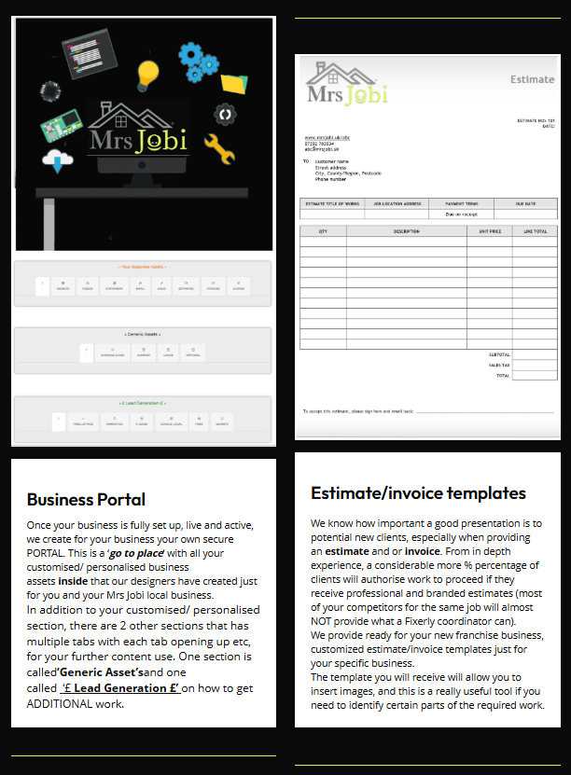
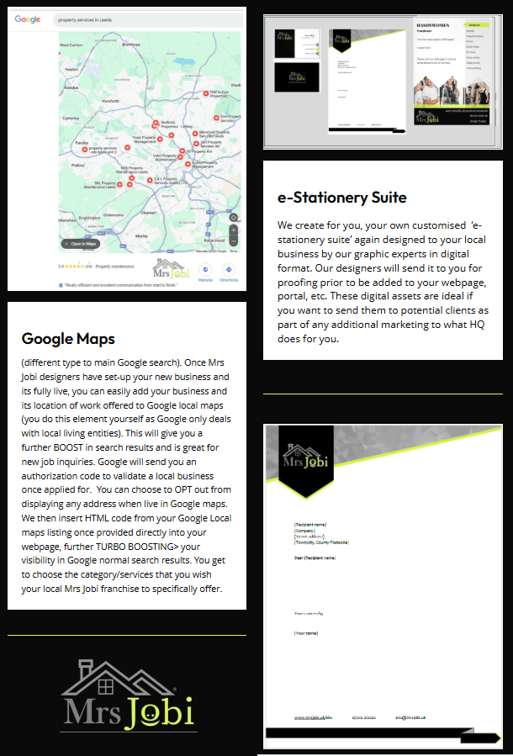
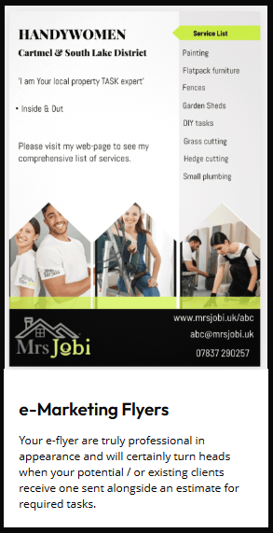

+ Plus a huge list also included
www.mrsjobi.uk/franchise

Slide 15




Questions?
Dominic
(franchise network manager)
info@mrsjobi.uk
07837 290257
www.mrsjobi.uk/franchise

